Slide 1
Heart Disease Diagnostic Analysis
Unified mentor Data analytics internship project
T shiva kumar yadav

Slide 2
Overview
This project focuses on performing diagnostic analysis for heart disease using machine learning techniques applied to medical data. The goal is to develop a predictive model that can accurately classify patients based on their health attributes and diagnostic test results, thereby assisting healthcare professionals in early detection and intervention.

Slide 3


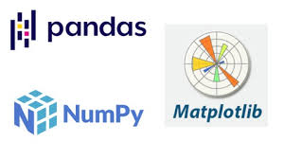
Tools and Technologies
Language: Python
Libraries : Pandas, NumPy, Matplotlib, Seaborn
Environment: Jupyter Notebook

Slide 4
Deliverables:
Jupyter Notebook with code and explanations.
Visualizations showcasing segmentation and insights.
Concise report summarizing analysis and recommendations.

Slide 5
Details of data
Columns: age', 'sex', 'cp', 'trestbps', 'chol', 'fbs', 'restecg', 'thalach', 'exang', 'oldpeak', 'slope', 'ca', 'thal', 'target’.
RangeIndex: 1025 entries, 0 to 1024

Slide 6
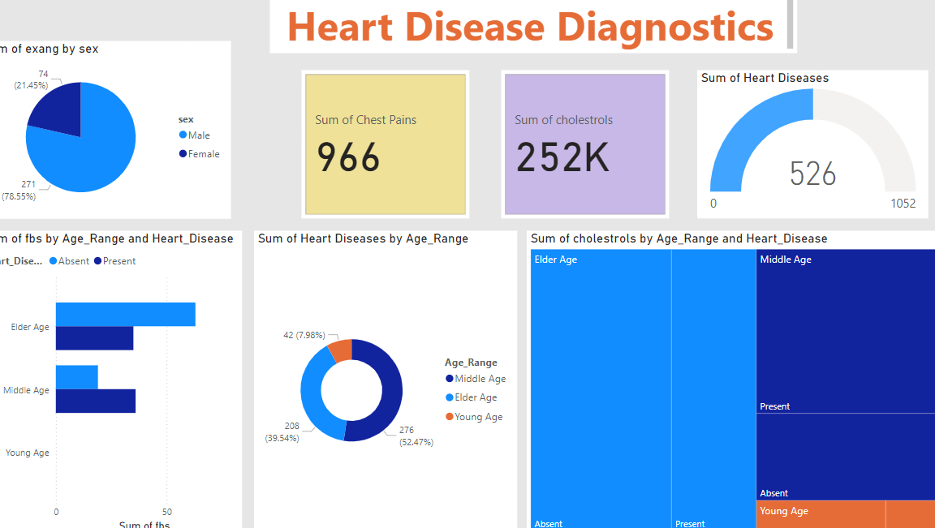
My Dashboard Using Power Bi Tool:

Slide 7
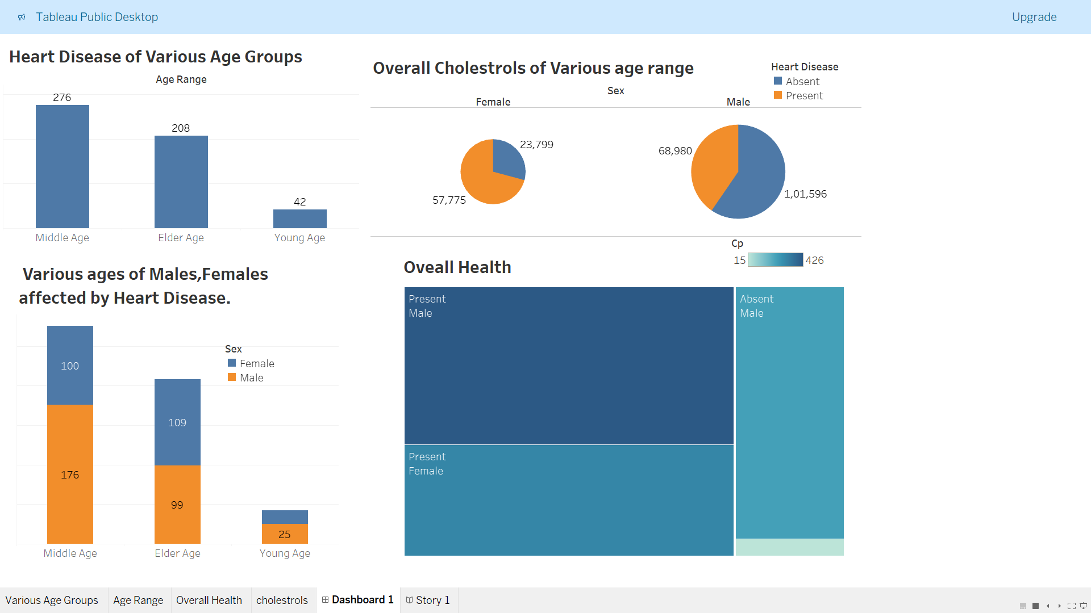
My Dashboard Using Tableau

Slide 8


